Slide 1


Machine learning to determine which customers should be prioritized for exceptional services
By: Mihir Thakkar

Slide 2

Agenda
Introduction
Problem Statement
Data Description
Data Analysis and Model Building
Conclusion & Actionable Insights
Future Improvements

Slide 3

Introduction
Our client for this project is a retail banking institution – AE Corp
They are going to float a stock trading facility for their existing customers.
The idea is to use data to classify whether a customer belongs to a high net worth or low net worth group.
They will have to incentivize their customers to adopt their offerings.
One way to incentivize could be to offer discounts on the commission for trading transactions.

Slide 4
Agenda
Introduction
Problem Statement
Data Description
Data Analysis and Model Building
Conclusion & Actionable Insights
Future Improvements

Slide 5
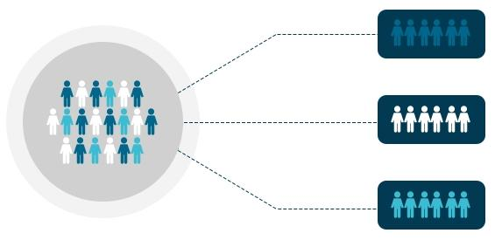
Problem Statement
The current process suffers from the following problems:
Only about 10% of the customers do enough trades for earnings after discounts to be profitable.
The company wants to figure out, which are those 10% customers so that it can selectively offer them a discount.

Slide 6

Problem Statement
Co-ordinating with - The marketing department to supplement their campaigns with a more proactive approach.
Our Role - To build a classification model using the datasets.
Project Deliverables - Predict whether a customer belongs to a high net worth or low net worth group.
Machine Learning Task: Classification
Target Variable: Status (high net worth (1) / low net worth (2))
Win Condition - No machine learning model in the company for this currently, therefore no quantifiable win condition. We just need to build the best possible model.
Evaluation Metric - The model evaluation will be based on the F1 Score score.

Slide 7
Agenda
Introduction
Problem Statement
Data Description
Data Analysis and Model Building
Conclusion & Actionable Insights
Future Improvements

Slide 8
Data Description
We are provided with a dataset containing all the necessary information about the customers like their occupation, family income, gender, region, balance transfer, children, etc.
Also included in the dataset is the column Revenue_Grid which classifies the customers into high net worth customers (1) and low net worth customers (2).
This is the data that we have to predict for future customers.
Train Set: The train set contains 8124 rows and 32 columns.The last column Revenue_Grid is the target variable.
Test Set: The test set contains 2031 rows and 31 columns.The test set doesn’t contain the Revenue_Grid column which need to be predicted

Slide 9
Agenda
Introduction
Problem Statement
Data Description
Data Analysis and Model Building
Conclusion & Actionable Insights
Future Improvements

Slide 10
Data Analysis and Model Building - 1

Slide 11
Data Analysis and Model Building - 2

Slide 12
Data Analysis and Model Building - 3

Slide 13
Agenda
Introduction
Problem Statement
Data Description
Data Analysis and Model Building
Conclusion & Actionable Insights
Future Improvements

Slide 14
Conclusion & Actionable Insights

Slide 15
Agenda
Introduction
Problem Statement
Data Description
Data Analysis and Model Building
Conclusion & Actionable Insights
Future Improvements

Slide 16
Future Improvements

